Slide 1
Requirement PC Server
Telkom IOT Center Andy Maulana Yusuf

Slide 2
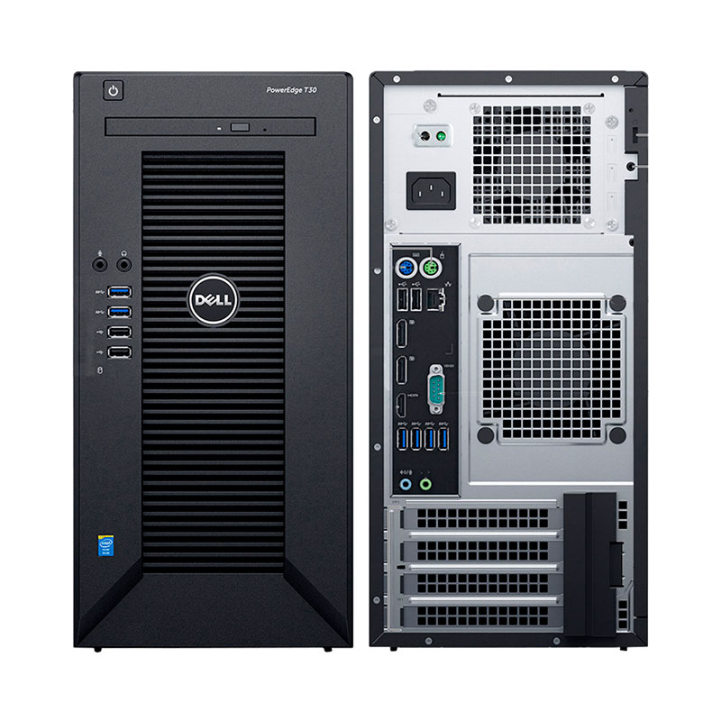
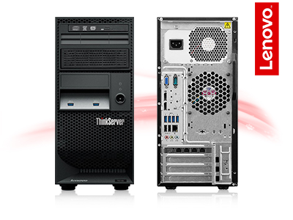
Small Business
Intel Xeon E3 Generation
Intel HD Graphics P Generation
16 GB Up To 64 GB (Must Be DDR4)
- 8x USB Port (3.0/2.0)
- Audio
- Video
- Serial
- 2x Display Port
- Gigabit Ethernet
H: 14inc, W: 7inc, D: 17inc
Linux Debian
IDR 12 – 15 jt
- Dell PowerEdge T30
- Lenovo ThinkServer TS150

Slide 3
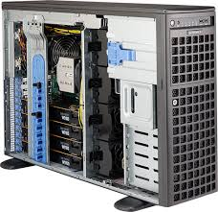
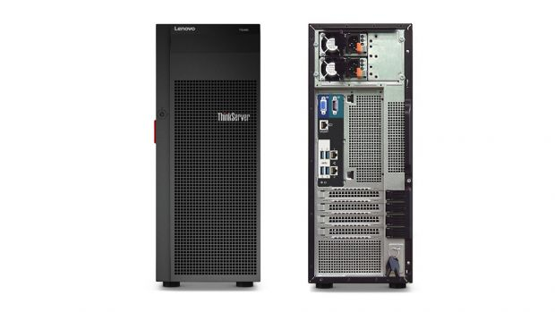
Medium Business
Intel Xeon E5 Generation
Intel HD Graphics P Generation
32 GB Up To 64 GB (Must Be DDR4)
- 12x USB Port (3.0/2.0)
- Audio
- Video
- Serial
- 2x Display Port
- Gigabit Ethernet
H: 14inc, W: 7inc, D: 17inc
Linux Debian
IDR 18 – 24 jt
- Supermicro SuperWorkstation 5039A-IL
- Lenovo ThinkServer TS460

Slide 4
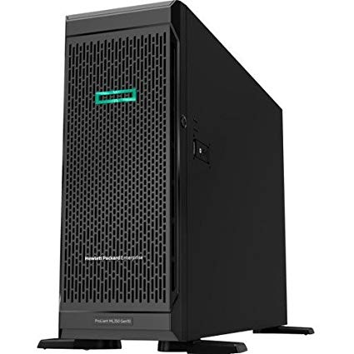
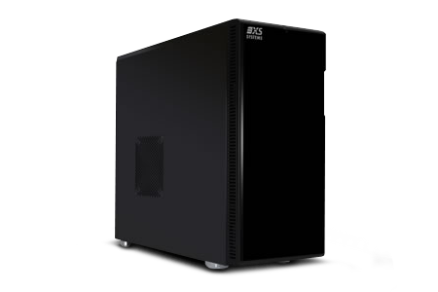
High Business
Intel Xeon E3 Generation
Nvidia GT Generation
64 GB Up To 64 GB (Must Be DDR4)
- 8x USB Port (3.0/2.0)
- Audio
- Video
- Serial
- 2x Display Port
- Gigabit Ethernet
H: 14inc, W: 7inc, D: 17inc
Linux Debian
IDR 30 – 80 jt
- HP ProLiant ML350
- Scan 3XS SER-T25
- Asus TS500

